Slide 1
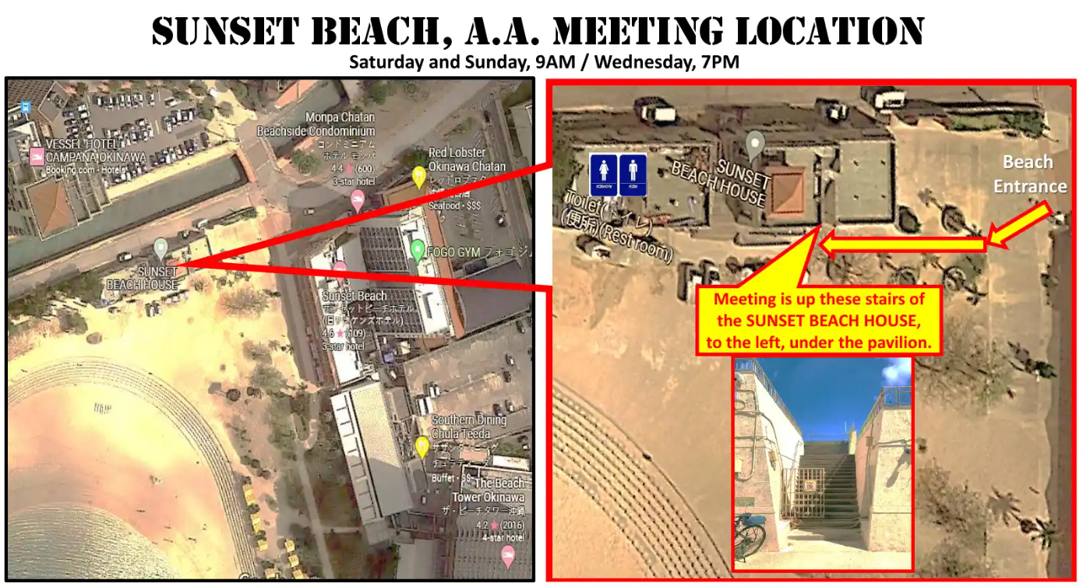

Slide 2
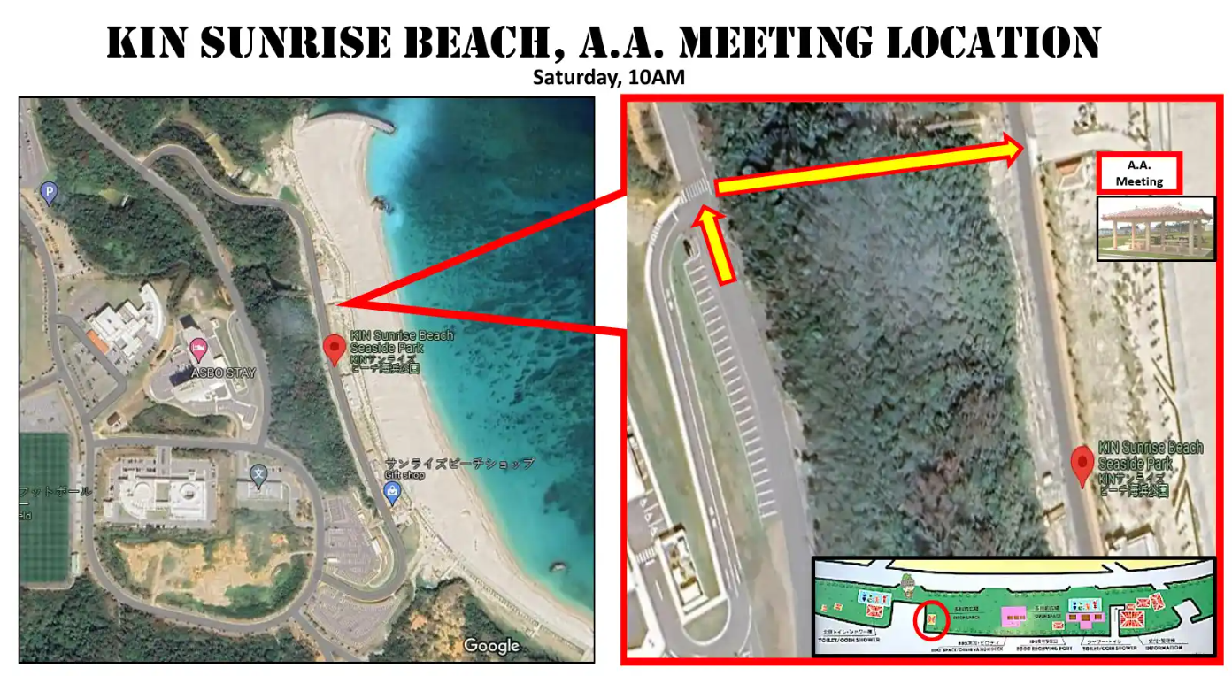

Slide 3
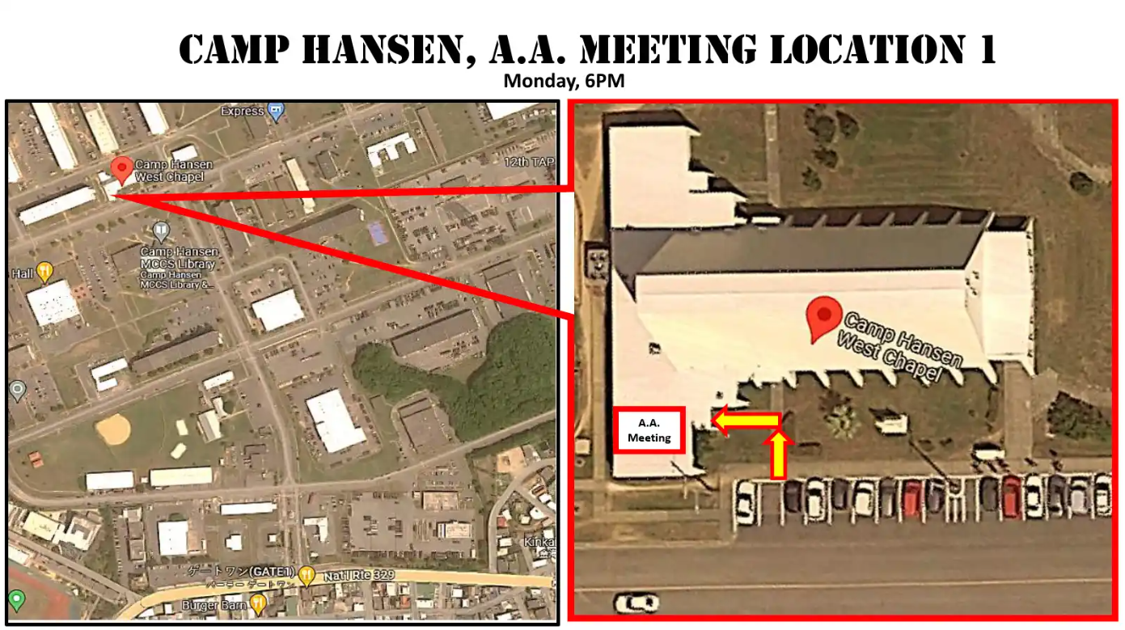

Slide 4
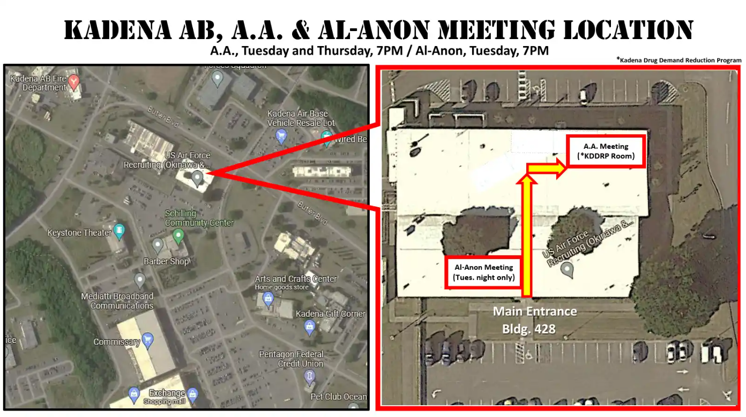
KADENA AB, A.A. MEETING LOCATION
Tuesday and Thursday, 7PM

Slide 5
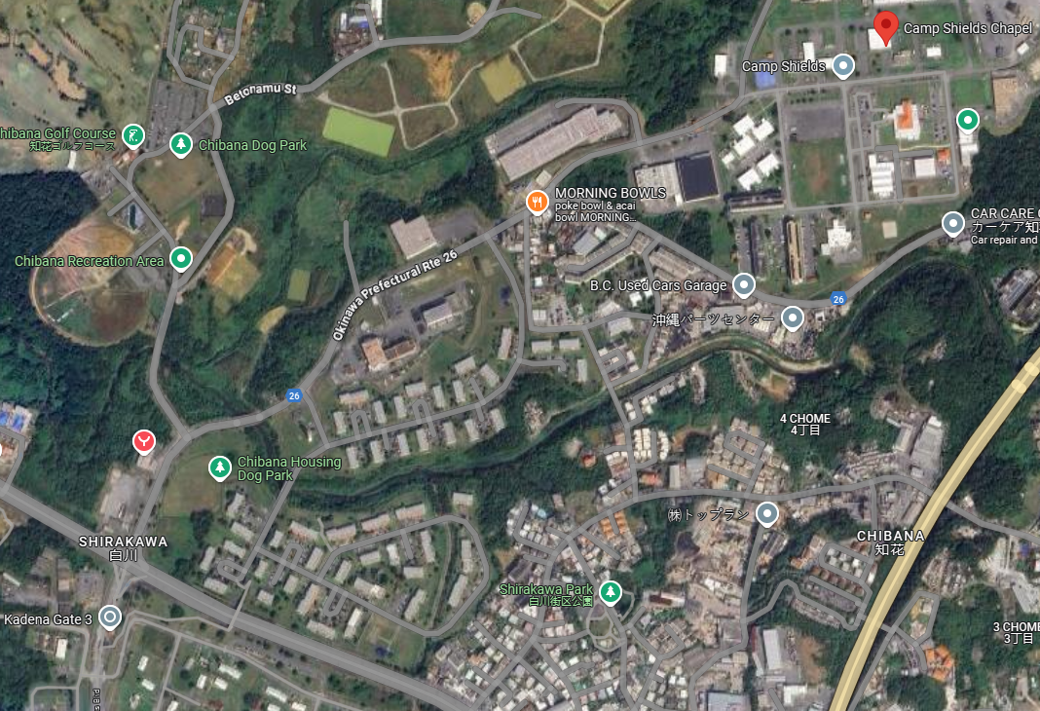
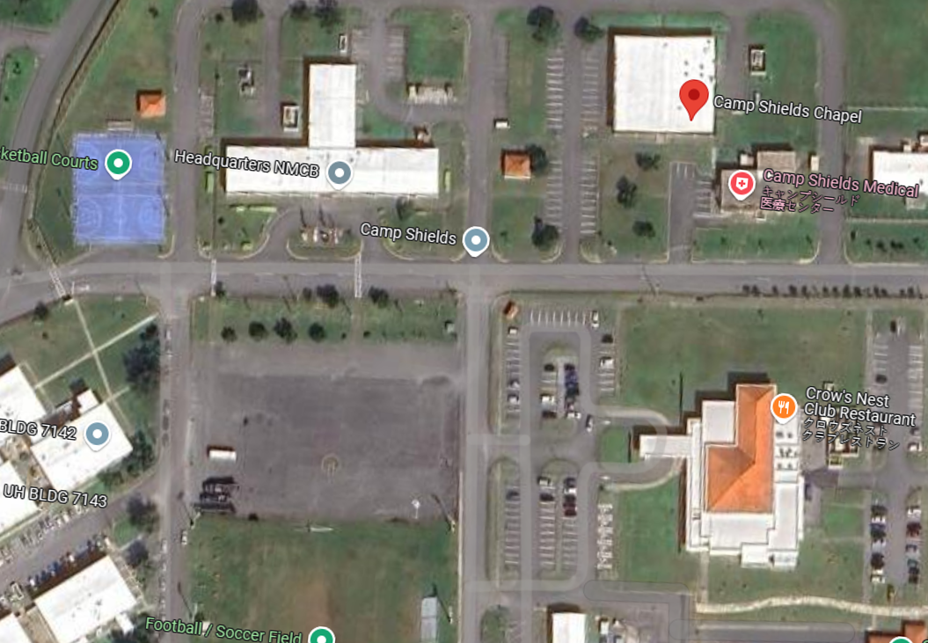
CAMP SHIELDS A.A. MEETING LOCATION
Wednesday, 7 PM
AA Meeting

Slide 6
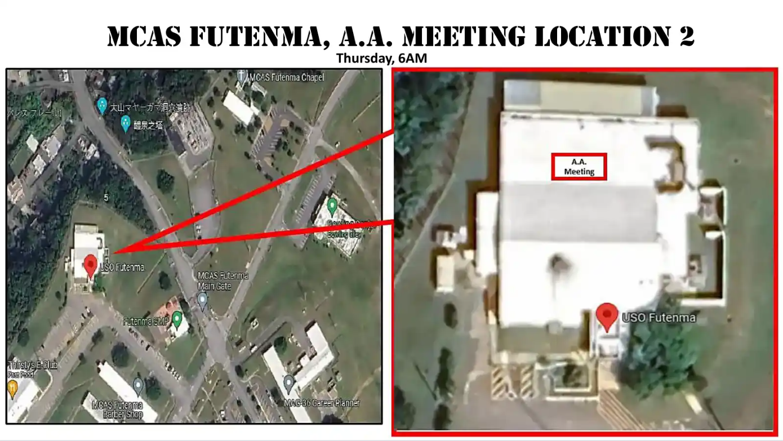
Disregard posted hours, door will be open

Slide 7
